Slide 1
Insertion sort

Slide 2
Insertion Sort
Similar to how most people arrange a hand of cards:
Start with one card in your hand.
Pick the next card and insert it into its proper sorted order.
Repeat previous step for all cards.

Slide 3
Insertion Sort
Example
40 | 13 | 20 | 8

Slide 4
Insertion Sort
Example
40 | 13 | 20 | 8
On first iteration we take second element and insert it into its proper sorted order

Slide 5
Insertion Sort
Example
13 | 40 | 20 | 8

Slide 6
Insertion Sort
Example
13 | 40 | 20 | 8
On second iteration we take third element and insert it into its proper sorted order

Slide 7
Insertion Sort
Example
13 | 20 | 40 | 8

Slide 8
Insertion Sort
Example
13 | 20 | 40 | 8
On last iteration we take the last element and insert it into its proper sorted order

Slide 9
Insertion Sort
Example
8 | 13 | 20 | 40
Array is sorted

Slide 10
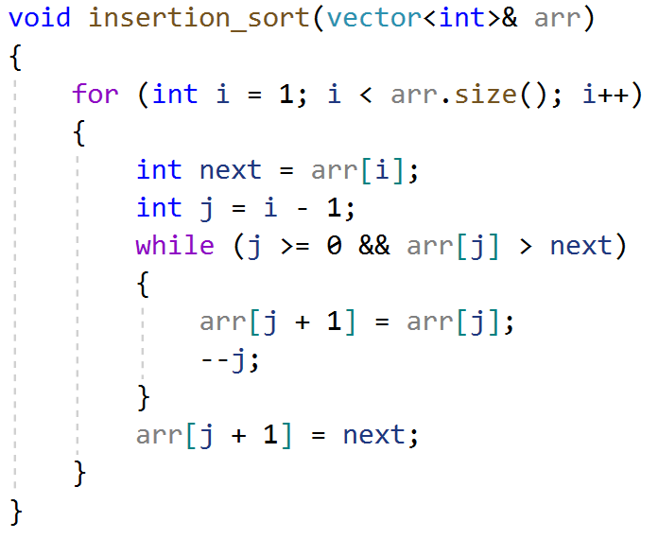
Insertion Sort
Implementation

Slide 11
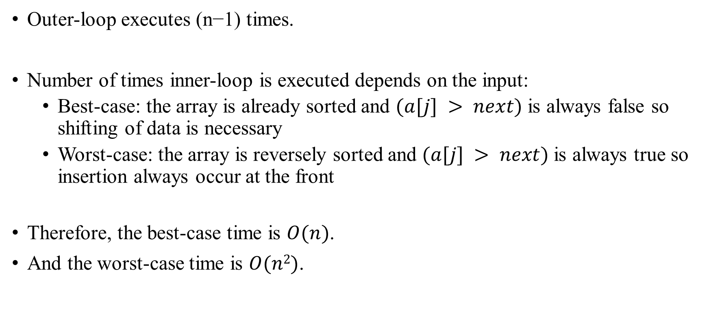
Insertion Sort
Analysis

